Slide 1
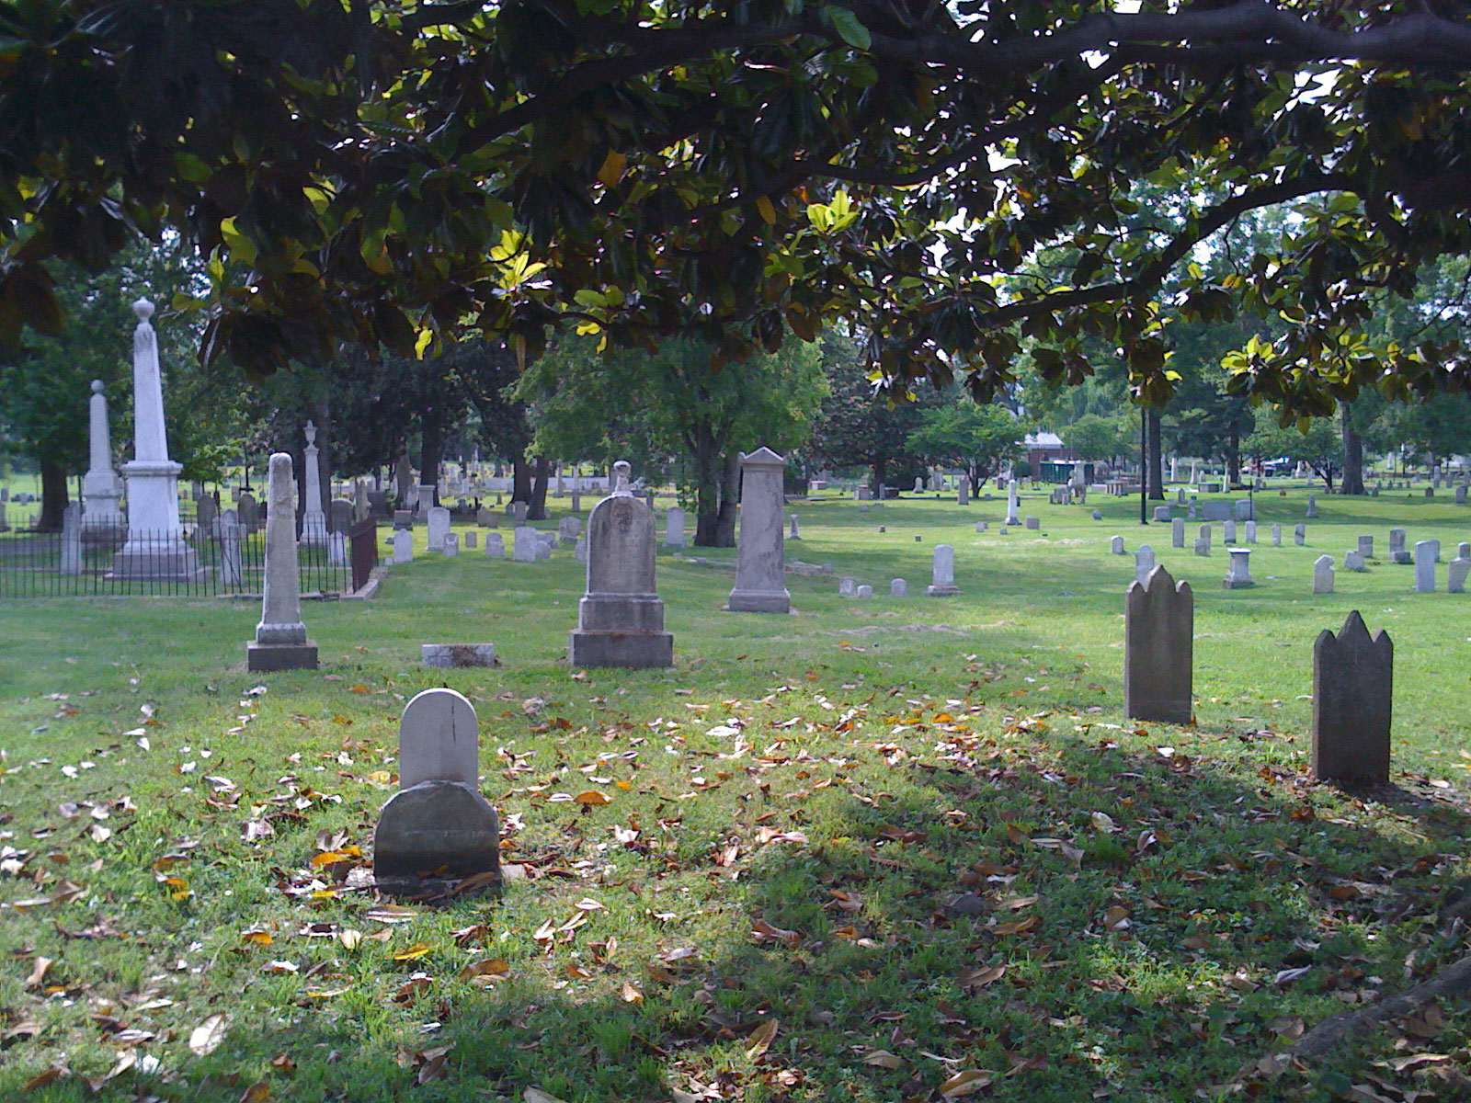
Dead-Telling Tales
A Data-Driven Primer for the Nashville City Cemetery
Prepared by Ed Brown

Slide 2
Overview
Basic Facts:
Located at 1001 4th Ave. S.
Opened in 1822
Designed by William Stickland, who also designed the Tennessee State Capitol
Added to the National Register of Historic Places on October 18, 1972
From 1846 - 1979: 19,745 people were buried in the Cemetery.
Of those with known causes, the most common causes of death were:
Consumption, aka Tuberculosis (1,769)
Stillbirth (1,301)
Cholera (1,244)
But there are many cases where the cause of death wasn’t clear, or the person died very suddenly - nearly 2,300.

Slide 3
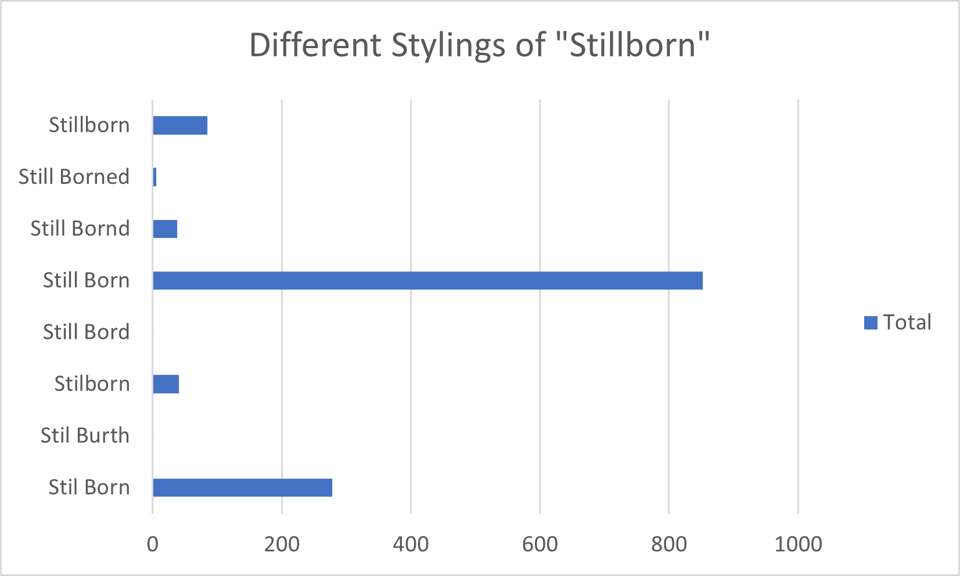
Testimonies from the Tombstones
The Cemetery - and its records - are a priceless resource to explore Nashville’s history.
Through them, we discover:
General literacy trends
Systems of labeling and record-keeping
Signs of medical advancement
And more
These all give great insights into how Nashvillians lived over the years …

Slide 4
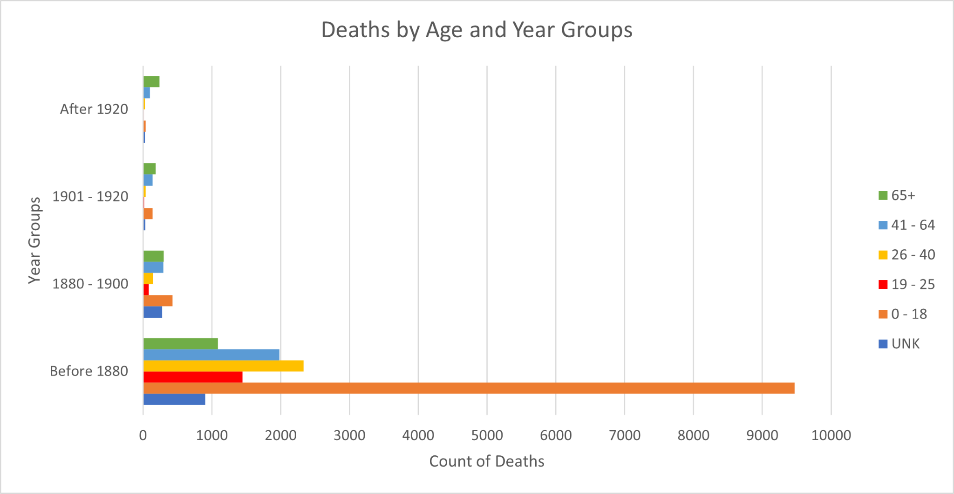
… And How They Died
Not only have the common causes of death evolved over the years, but the ages of people affected have, as well.

Slide 5
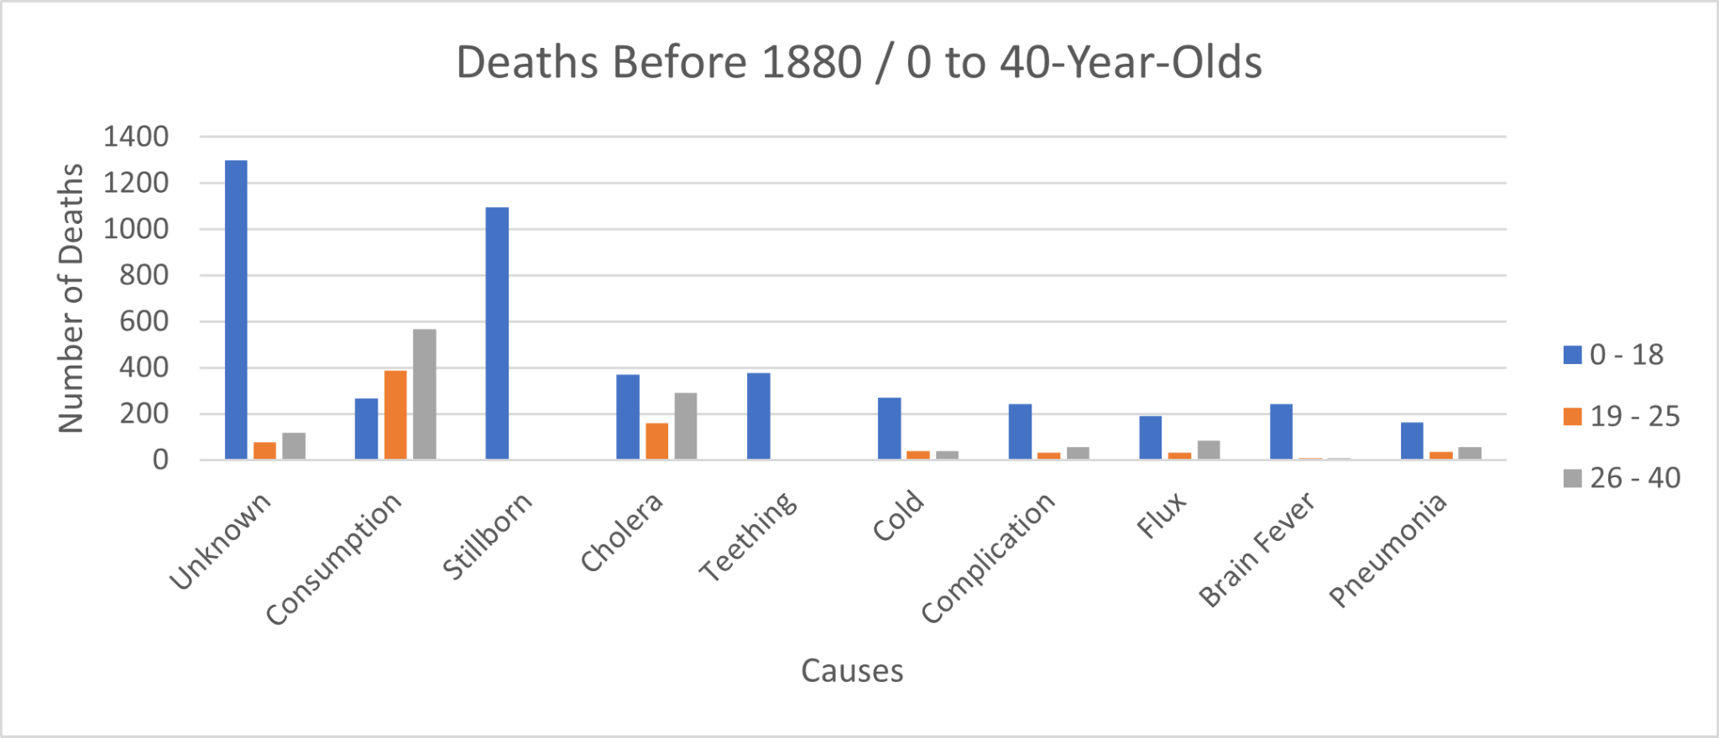
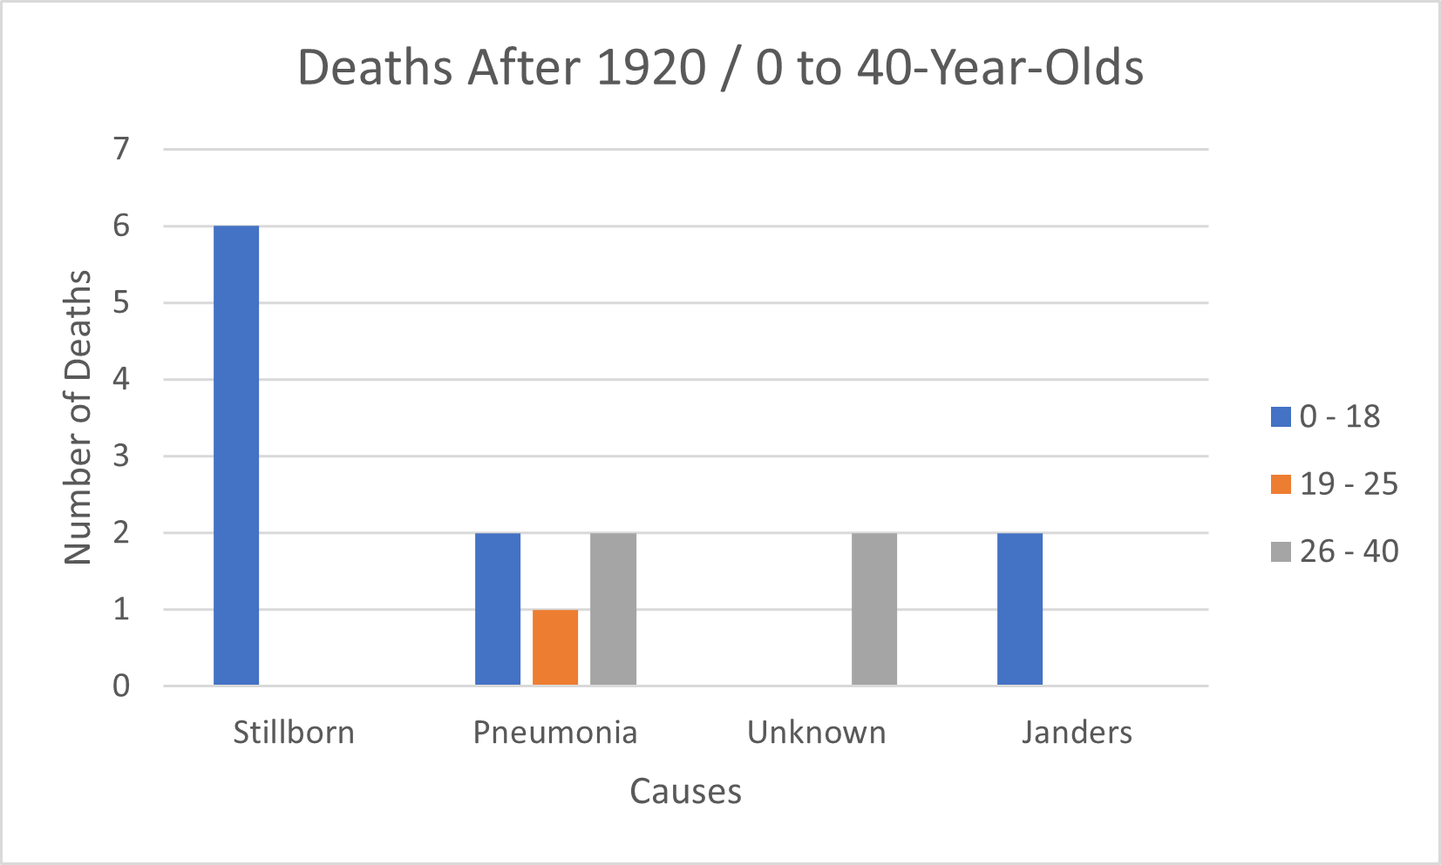
“Only the Good Die Young”
Prior to 1880, the vast majority of deaths recorded were between 0 and 40 years old … and most were in the 0 – 18 range.
From the 1920s onward, burials of 40-and-younger people had declined significantly.

Slide 6
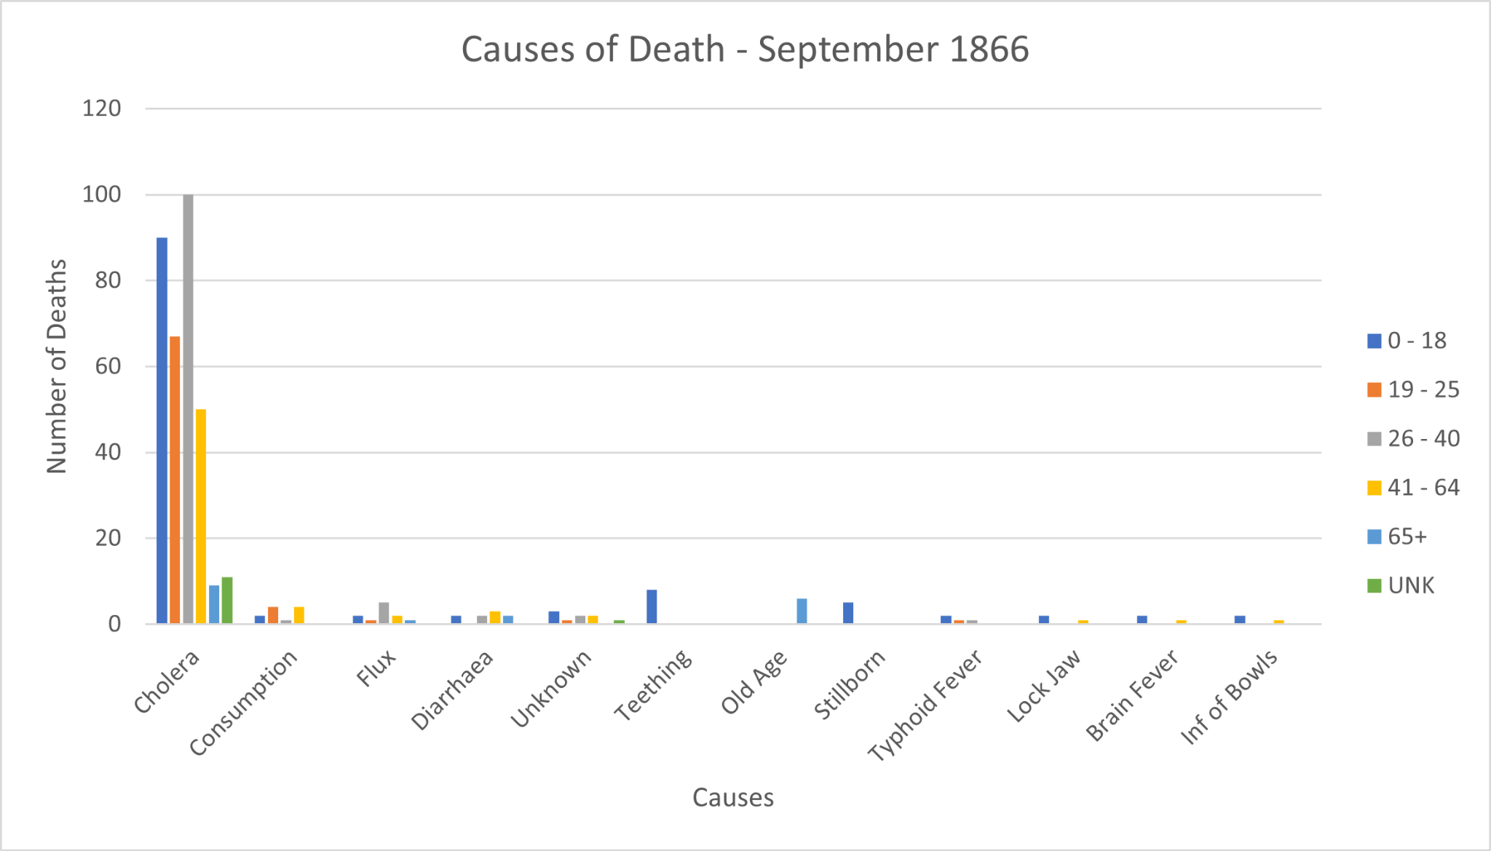
The Deadliest Month in Nashville City Cemetery History
While the Civil War period (1860-1865) saw many Nashvillians die - more than 5,000 - the most lethal month in the Cemetery’s history came more than a year after the war ended.
September 1866 saw 441 people buried in the Cemetery, the most in any single month from 1842 to 1979.
Of those, 327 - roughly 74% - died from Cholera.
By comparison, the next most lethal month - July 1850, at the height of the Cholera epidemic - saw 370 burials.

Slide 7
Questions?

